Slide 1

Geometry
Unit 1, Lesson 12 Angle Bisectors Volume 1, pg. 75

Slide 2


Benchmarks
MA.912.GR.1.1
Prove relationships and theorems about lines and angles. Solve mathematical and real-world problems involving postulates, relationships, and theorems of lines and angles.
MA.912.GR.5.2
Construct the bisector of a segment or an angle, including the perpendicular bisector of a line segment.
volume 1, pg. 75

Slide 3
Integrated Mathematical Thinking and Reasoning Standards
MA.K12.MTR.1.1 Actively participate in effortful learning both individually and collectively.
MA.K12.MTR.2.1 Demonstrate understanding by representing problems in multiple ways.
MA.K12.MTR.4.1 Engage in discussions that reflect on the mathematical thinking of self and others.
MA.K12.MTR.5.1 Use patterns and structure to help understand and connect mathematical concepts.
volume 1, pg. 75

Slide 4

Learning Target
I can construct an angle bisector.
volume 1, pg. 75

Slide 5

Warm-Up
volume 1, pg. 75

Slide 6
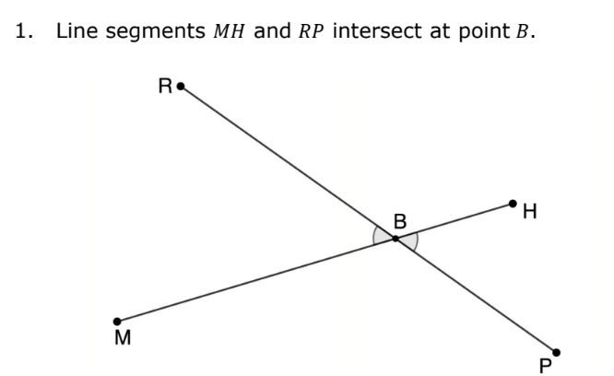
1.12.1 Warm-Up: Agree of Disagree
volume 1, pg. 75

Slide 7
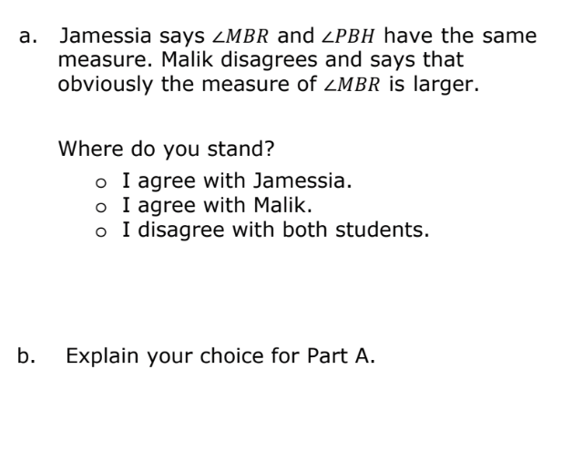
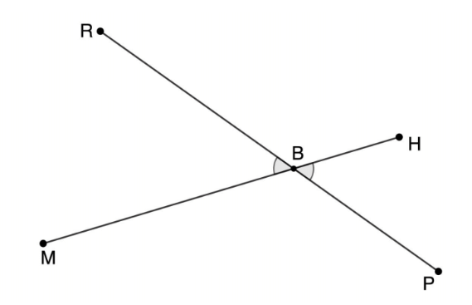
volume 1, pg. 75

Slide 8

Collaboration
volume 1, pg. 76

Slide 9

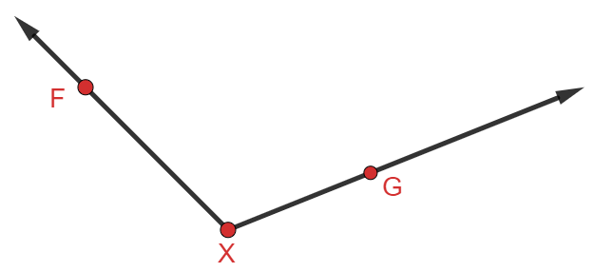
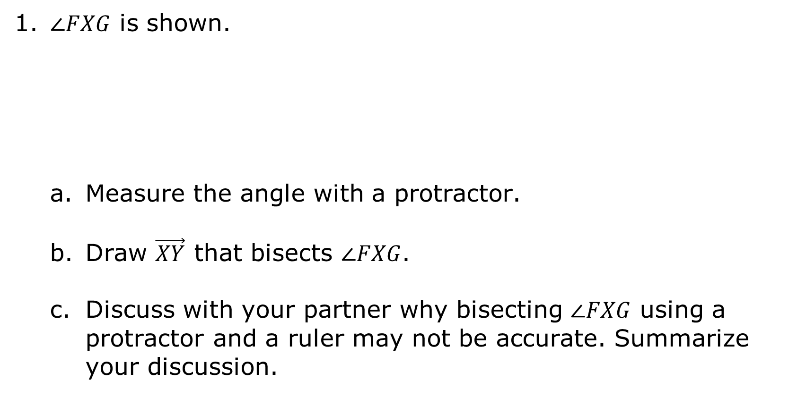
1.12.2 Collaboration: Bisecting an Angle
1. $∠FXG$ is shown.
Measure the angle with a protractor.
Draw $\vec{XY}$ that bisects $∠FXG$.
Discuss with your partner why bisecting $∠FXG$ using a protractor and a ruler may not be accurate. Summarize your discussion.
volume 1, pg. 76

Slide 10
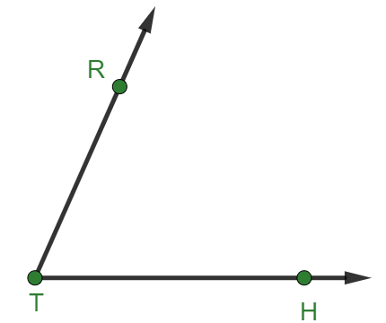

2. $∠RTH$ is shown.
Use patty paper to copy $∠RTH$.
Fold the patty paper so that $\vec{TR}$ and $\vec{TH}$ lie on each other. Open the paper and draw $\vec{TM}$ along the crease.
Explain how folding the patty paper bisects the angle.
volume 1, pg. 76

Slide 11
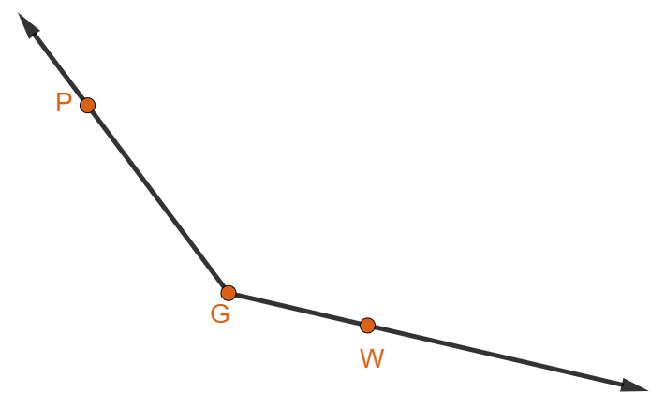
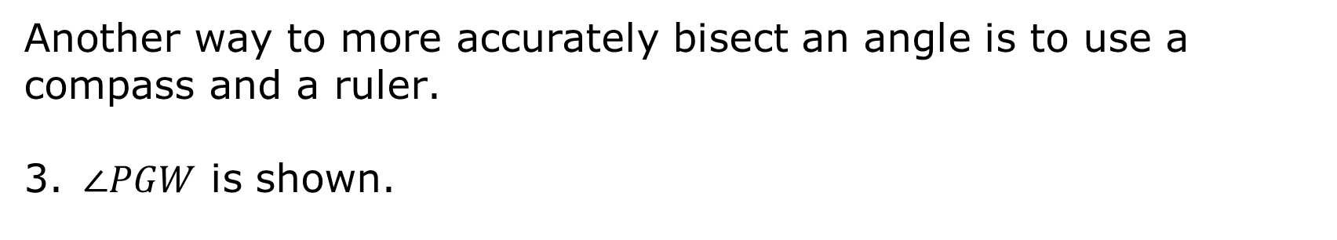
Another way to more accurately bisect an angle is to use a compass and a ruler.
3. $∠PGW$ is shown.
volume 1, pg. 77

Slide 12
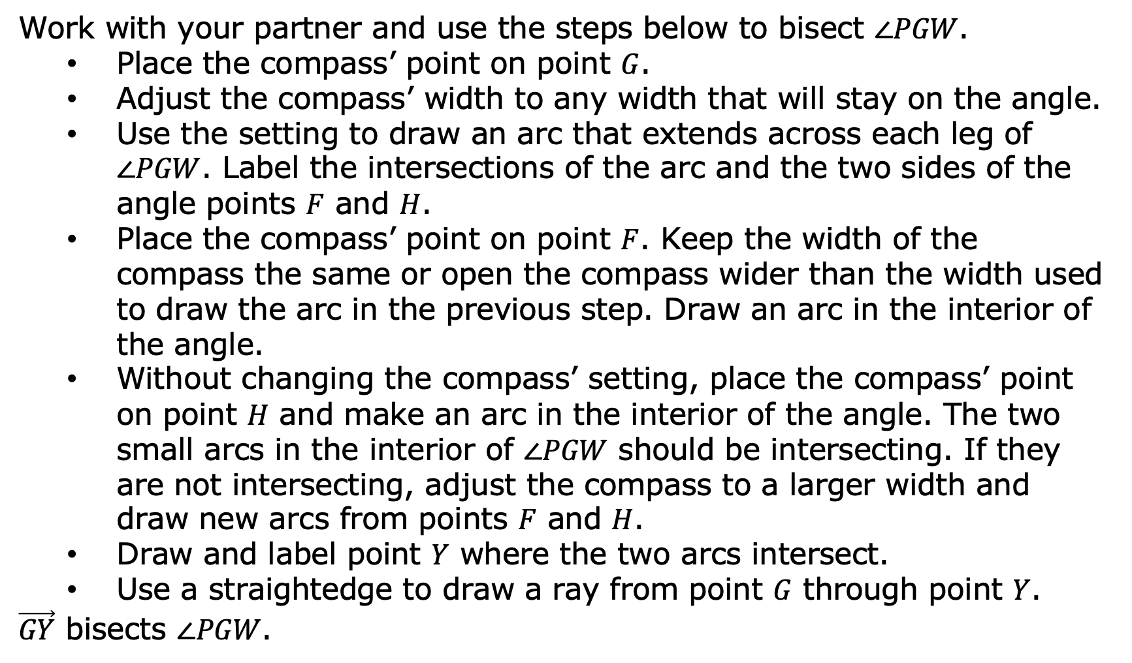
Work with your partner and use the steps below to bisect $∠PGW$.
Place the compass’ point on point $G$.
Adjust the compass’ width to any width that will stay on the angle.
Use the setting to draw an arc that extends across each leg of $∠PGW$. Label the intersections of the arc and the two sides of the angle points $F$ and $H$.
Place the compass’ point on point $F$. Keep the width of the compass the same or open the compass wider than the width used to draw the arc in the previous step. Draw an arc in the interior of the angle.
Without changing the compass’ setting, place the compass’ point on point $H$ and make an arc in the interior of the angle. The two small arcs in the interior of $∠PGW$ should be intersecting. If they are not intersecting, adjust the compass to a larger width and draw new arcs from points $F$ and $H$.
Draw and label point $Y$ where the two arcs intersect.
Use a straightedge to draw a ray from point $G$ through point $Y$.
$\vec{GY}$ bisects $∠PGW$.
volume 1, pg. 77

Slide 13
Olivia found some steps for bisecting an angle on the internet. She wrote them down and then mixed them up to test herself. Her mixed-up steps are shown. Work with your partner to order the steps 1-9.
 | Draw a ray from the vertex of the angle to the intersection of the two small arcs.
 | Stretch the compass to any length that stays on the angle.
 | Without changing the span on the compass, place the point of the compass on the other point made by the arc and the other side of the angle and make a similar arc.
 | Place the compass point on one of the two new points made by the arc.
volume 1, pg. 77

Slide 14
 | Change the compass width so that the pencil stays between the rays of the angle.
 | Place compass point on the vertex of the angle.
 | Swing the compass to make an arc that crosses both rays of the angle.
 | Draw an arc in the interior of the angle.
 | Mark the point where the two small arcs in the interior of the angle intersect.
volume 1, pg. 77

Slide 15

Guided Instruction
volume 1, pg. 78

Slide 16
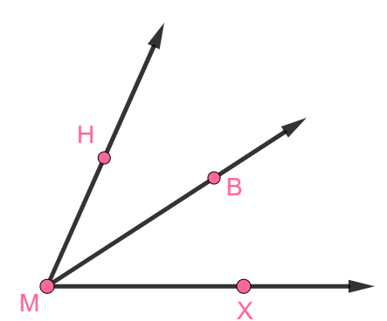
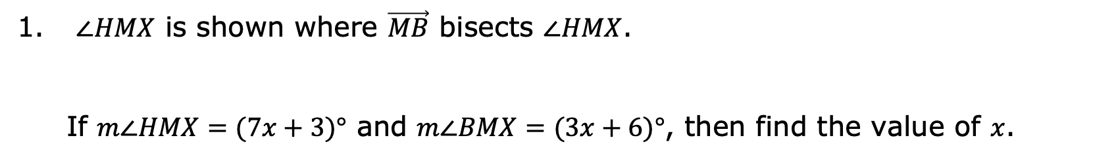
1.12.3 Guided Instruction: Using Angle Bisectors to Solve Problems
An angle bisector is a line, ray, or line segment that cuts an angle into two equal parts.
$∠HMX$ is shown where $\vec{MB}$ bisects $∠HMX$.
If $m∠HMX=(7x+3)°$ and $m∠BMX=(3x+6)°$, then find the value of $x$.
volume 1, pg. 78

Slide 17
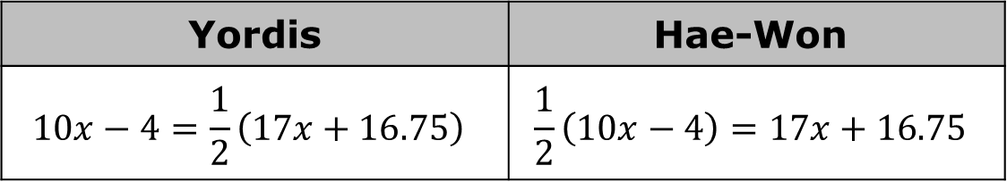
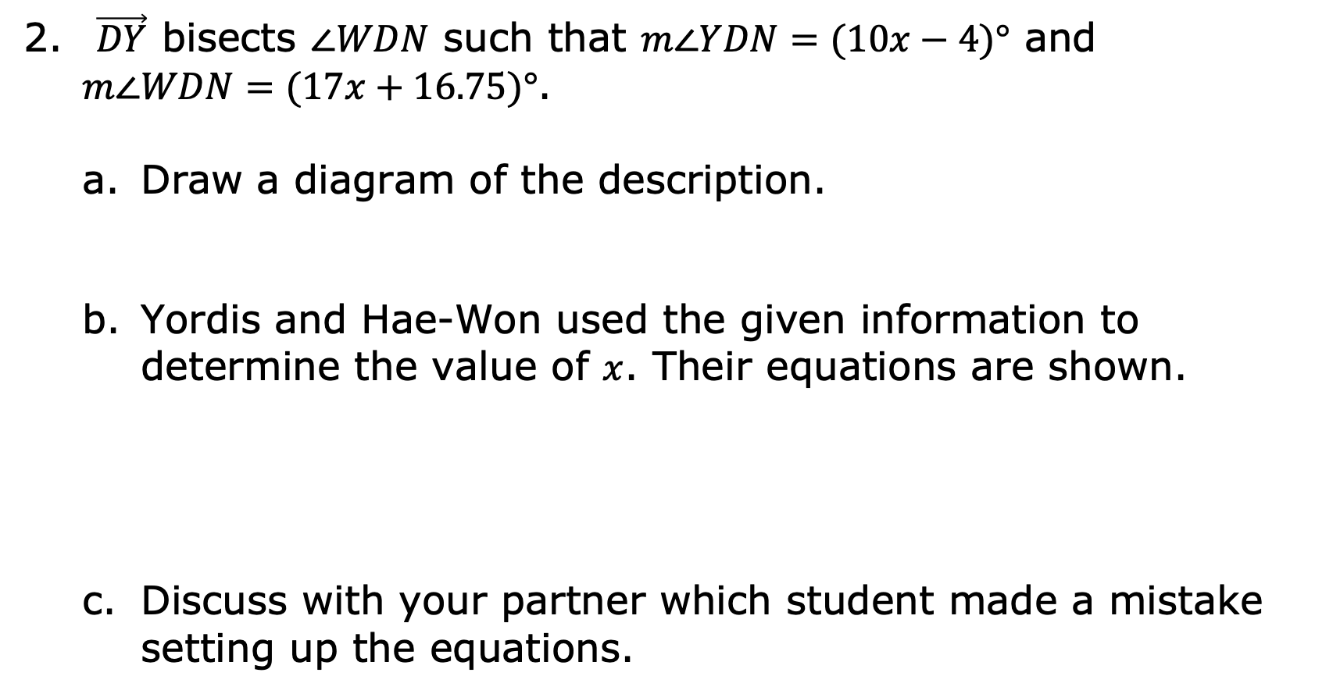
$\vec{DY}$ bisects $∠WDN$ such that $m∠YDN=(10x−4)°$ and $m∠WDN=(17x+16.75)°$.
Draw a diagram of the description.
Yordis and Hae-Won used the given information to determine the value of $x$. Their equations are shown.
Discuss with your partner which student made a mistake setting up the equations.
Yordis | Hae-Won
$$10x−4=\frac{1}{2}\left(17x+16.75\right)$$ | $$\frac{1}{2}\left(10x−4\right)=17x+16.75$$
volume 1, pg. 78

Slide 18

Write a short note to the student who made a mistake in setting up the equations to explain their error to them.
$\vec{BT}$ bisects $∠HBN$ such that $m∠HBN=(10x−2)°$, $m∠HBT=(5x−1)°$, and $m∠TBN=(7x−23)°$. Find $m∠TBN$.
Means
I
Start
To
Acquire
Knowledge
Experience
Skills
volume 1, pg. 78

Slide 19

Wrap-Up
volume 1, pg. 79

Slide 20
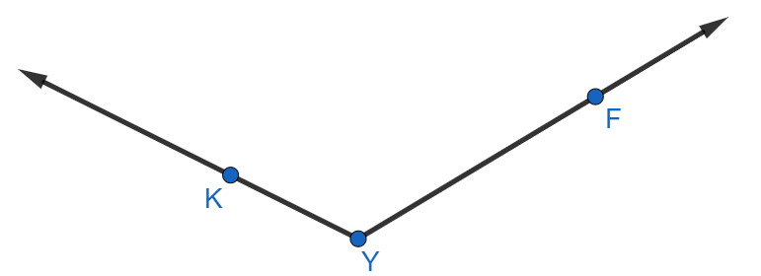
1.12.4 Wrap-Up: Ticket Out the Door
Construct the angle bisector of $∠KYF$ using a compass and a straightedge.
volume 1, pg. 79

